Slide 1

7023T
Advanced Database Systems
Session 03
Enrichment Activity
Introducing the Technical Architecture
This presentation is based on Michael A. Fudge, Jr.

Slide 2
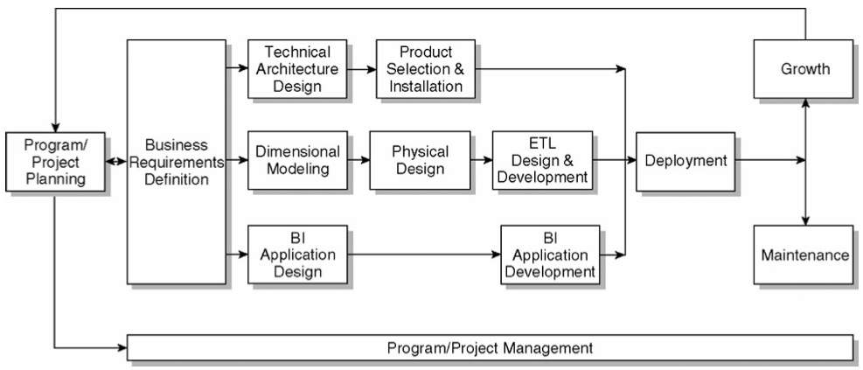
The Kimball Lifecycle Diagram

Slide 3
Architecture != Infrastructure
Technical Architecture
Technical Infrastructure
A Framework of rules, decisions, and structures for the overall design of a system.
A physical means of implementing a technical architecture through hardware and software.

Slide 4
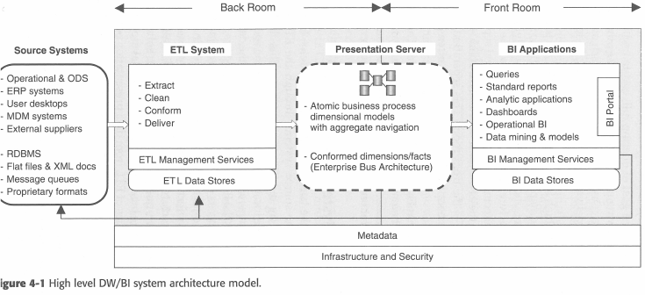
Kimball: DW/BI System Architecture Model
Notes:
Back room - hidden from end-user
Front room – user interacts with these components

Slide 5
Back Room and Front Room Architectures
Back Room
Front Room
Behind the scenes.
No direct interaction with the business users.
Business users see and interact with this architecture.

Slide 6
3 System Architectures
Back-Room: ETL System (We’ll cover this next class)
Back-Room and Front Room: Presentation Server (We’ve covered this already)
Front-Room: BI Applications (We’ll cover this in 2 classes)

Slide 7
Metadata
The information that describes our technical architecture.
Spans all 3 System Architectures: Back, Presentation & Front.
Technical Metadata – Infrastructure oriented. Indexes, table partitions, data types, data transformations.
Business Metadata – User oriented. Data structure definitions, Data dictionaries, implicit data hierarchies.
Process Metadata – System oriented. Performance metrics and measurements. The Audit Dimension.

Slide 8
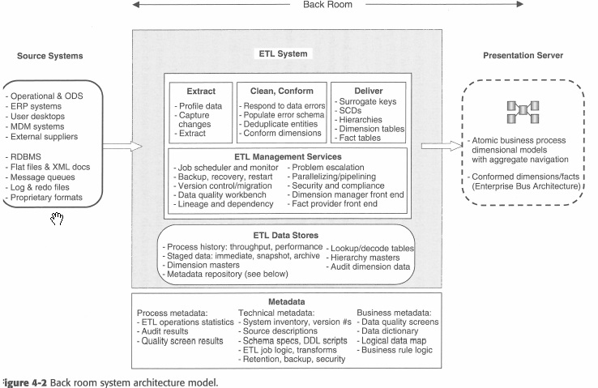
Back Room Architecture
Behind the scenes.
No direct interaction with the business users.
ETL System + Parts of the Presentation Server

Slide 9
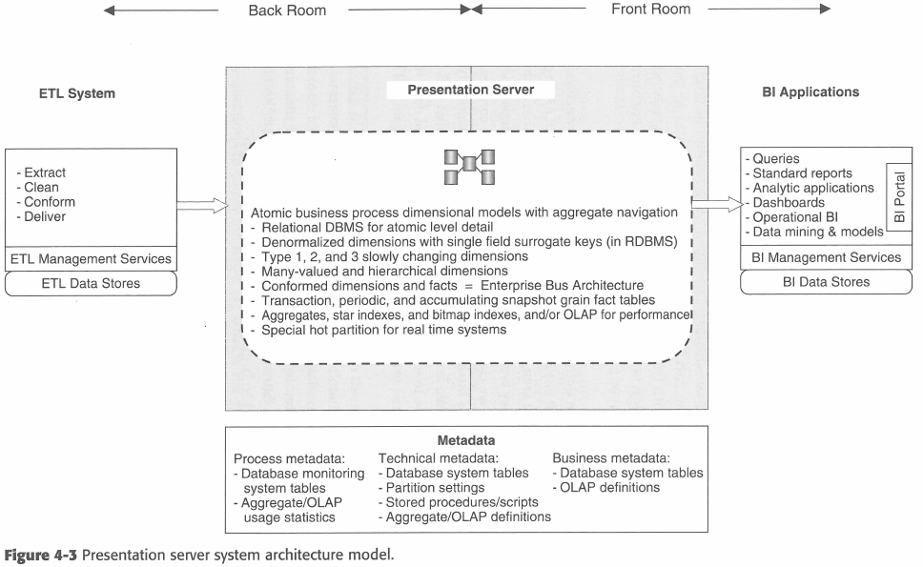
Presentation Server Architecture
Dimensional Models as ROLAP Star Schemas, MOLAP Cubes
Enterprise Bus Architecture
Conformed Dimensions across fact tables.

Slide 10
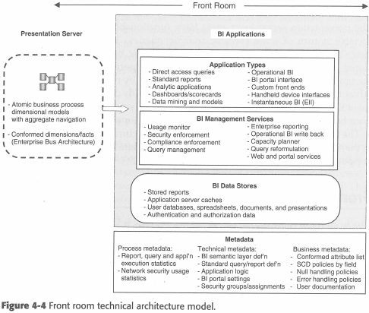
Front-Room Architecture
Business users see and interact with this architecture.
Business Intelligence
Reports, Cube Explorers, Data mining, Dashboards, Scorecards.

Slide 11
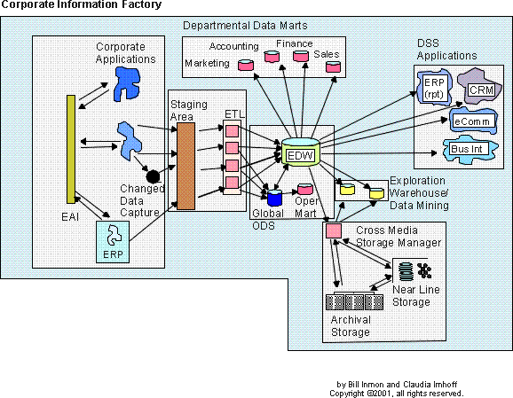
Kimball v Inmon
Compare and contrast to the CIF:
Front / Back Room?
ETL / PS / BI?
Similarities?
Differences?

